Slide 1
DataFest 2025
Sam Castillo

Slide 2
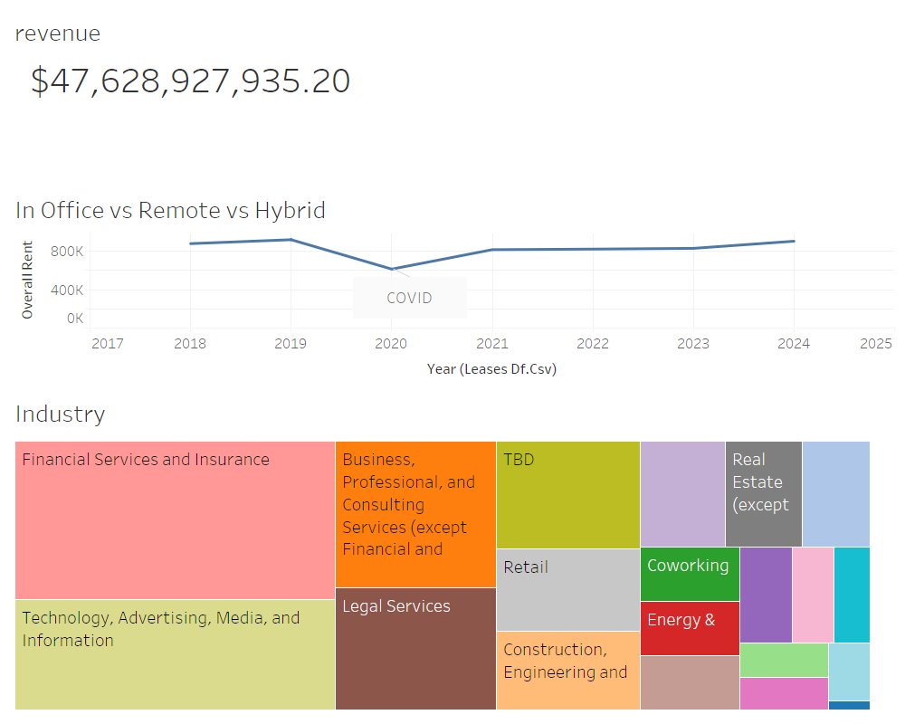

Slide 3
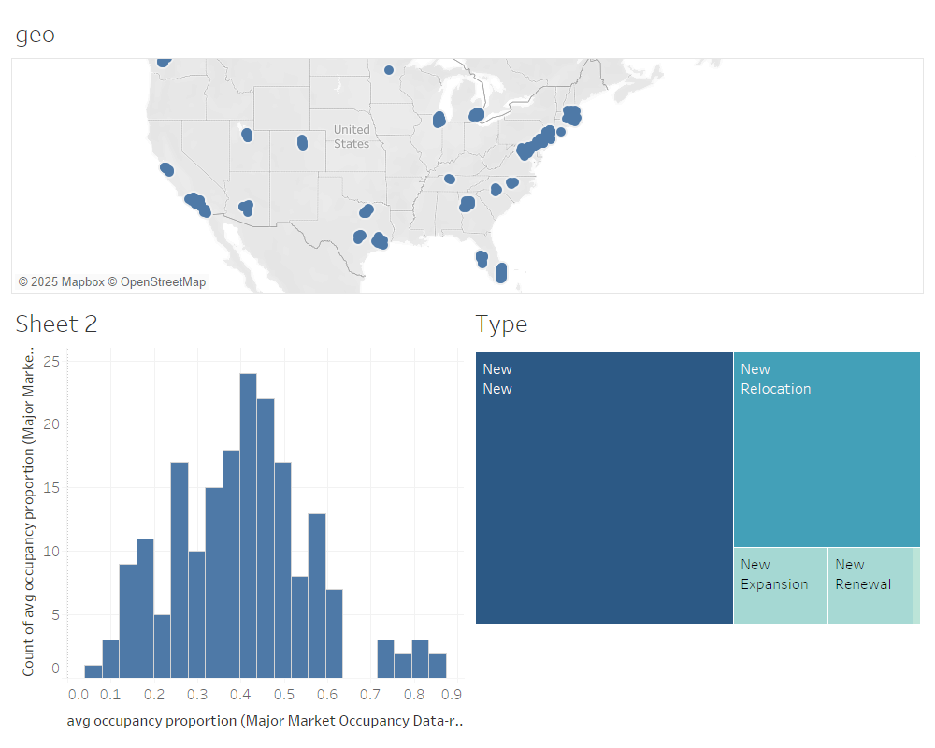

Slide 4
Solutions for Major Companies

